Slide 1

Hawaii Hazard Readiness Dashboard CPT Ma, Michael NPS DL OA3802 10SEP25

Slide 2



Introduction: What’s the Why?
Problem
Impact
Solution
Hazard information for Hawaii is scattered across agencies, their respective websites, and a trend of inconsistent data formats. This presents a serious challenge in forming a timely, accurate, and unified picture.
Delays and mistakes in situational awareness, uneven data quality, and difficulty communicating a shared view to stakeholders.
One live map that cleans and consolidates hazard data, cuts visual clutter, and shows only what’s immediately important to the stakeholder.

Slide 3
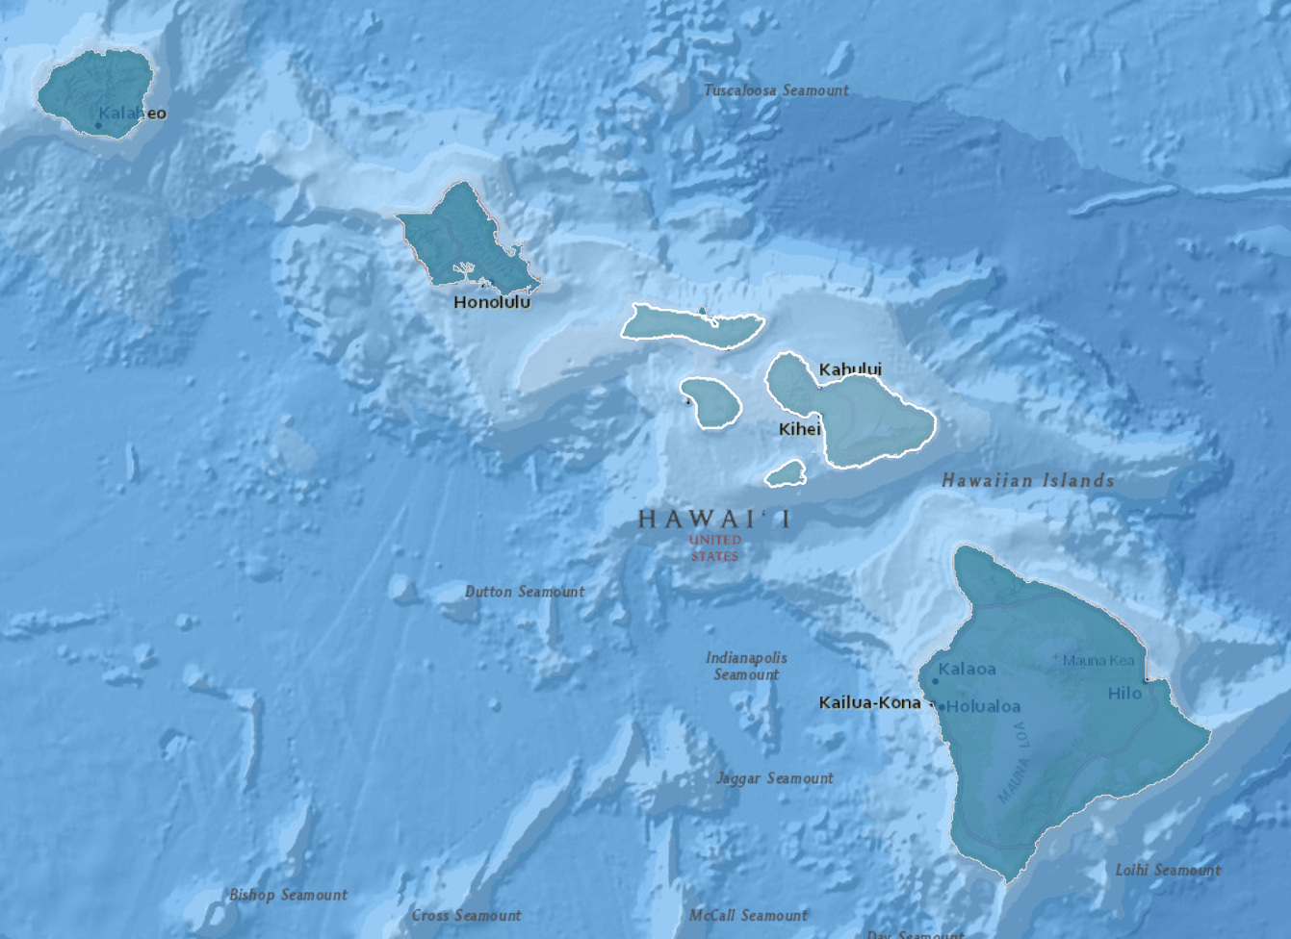
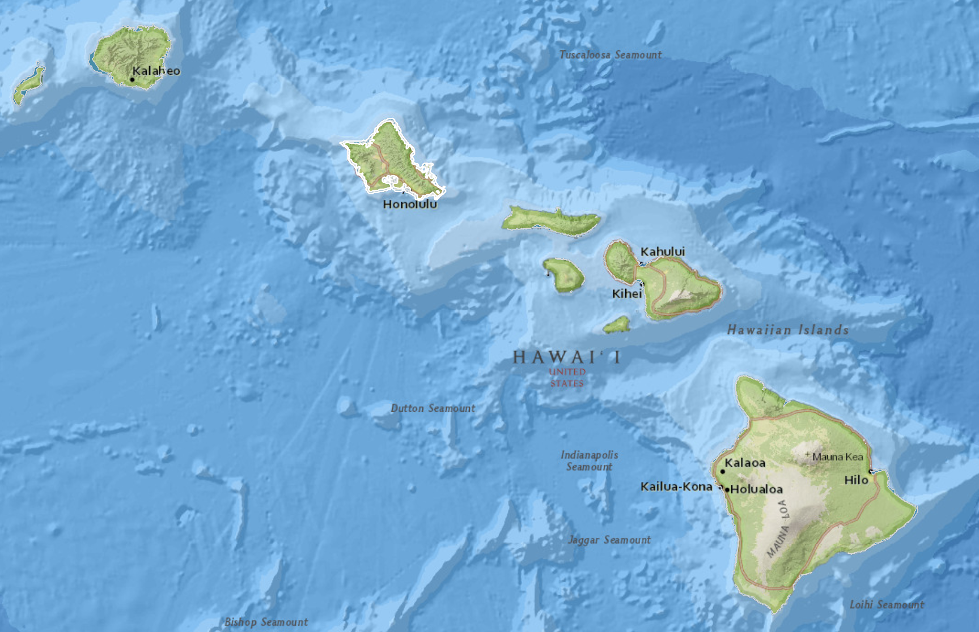
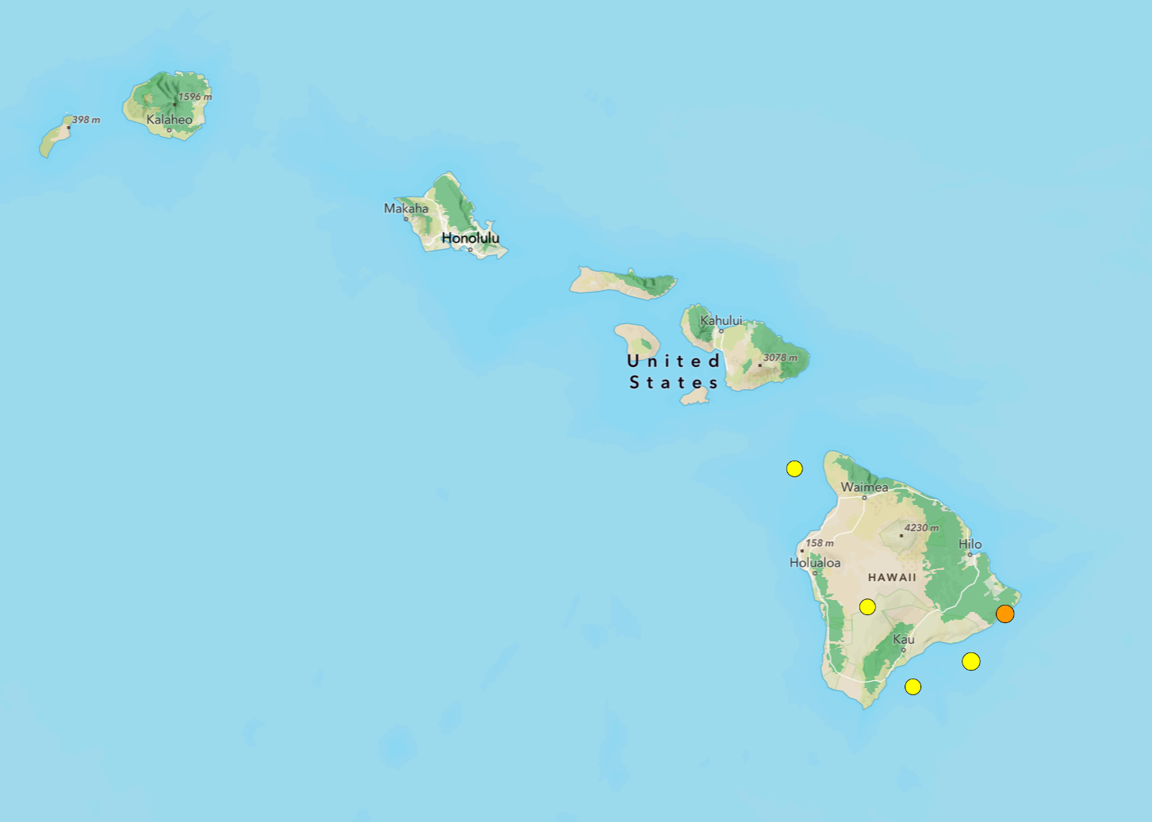
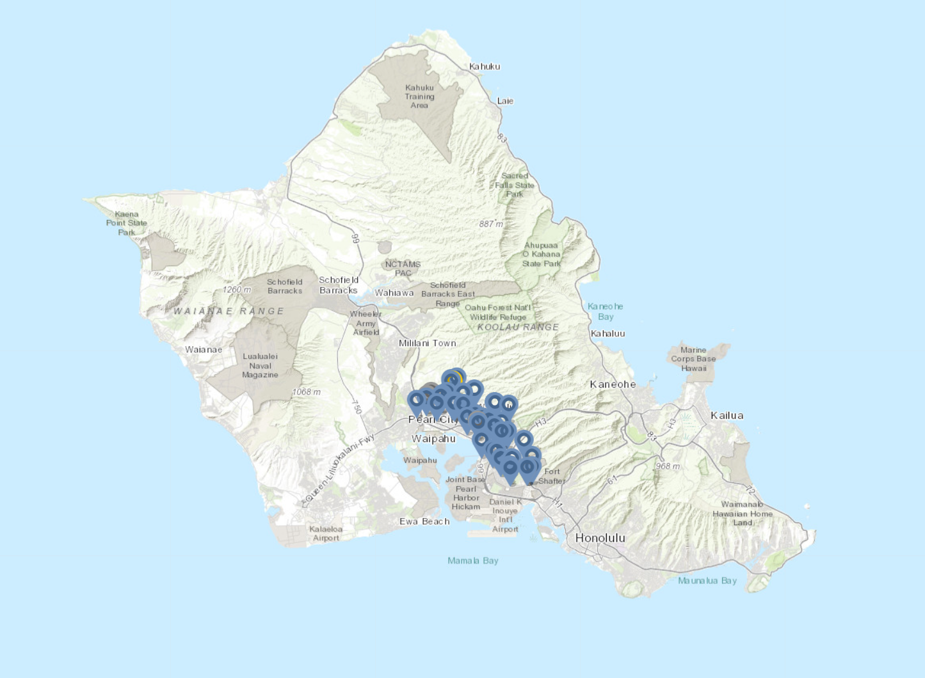
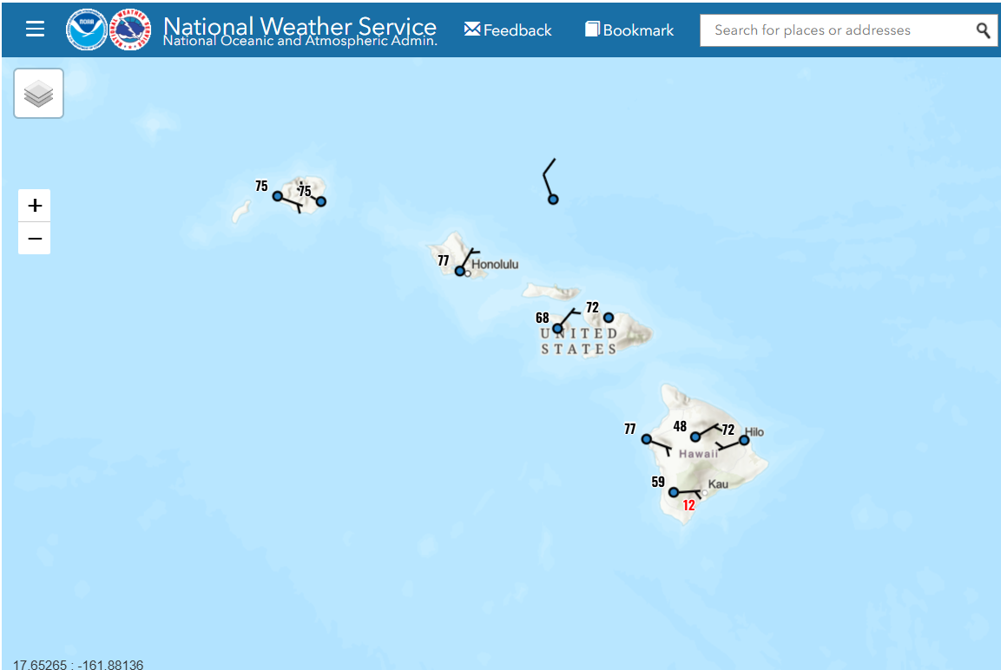
Introduction: What’s the Why?
US Census
Hawaii Counties
Hawaii GIS
Tsunami Zones
USGS
Earthquakes
Honolulu 311
Citizen-submitted Reports
National Weather Service
Weather Alerts

Slide 4
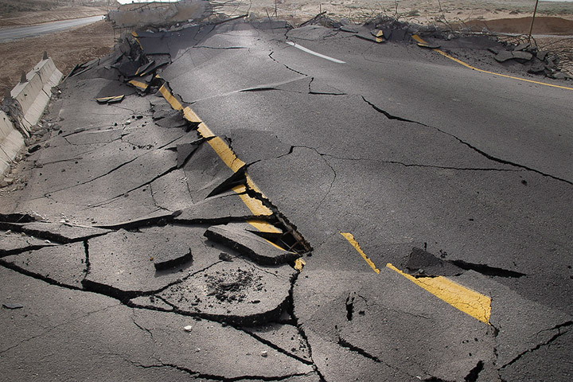
USGS: Earthquakes
Phase 1 — Acquire
Data Source: earthquake.usgs.gov
Method: HTTP GET (FSDN API)
Data Type: GeoJSON
Specified Parameters:
Start/End (previous 7 days)
Minimum Magnitude ≥ 2.5
Epicenter (Latitude/Longitude)
Phase 2 — Normalize
Extract GeoJSON Features to DF
Select: properties.time, properties.mag, geometry.coordinates [lon, lat]
Local Time Conversion:
Convert epoch to HST
Phase 3 — Shape for Map
Convert DF to GeoDF:
Select: quake_time_ms, magnitude ,lon, lat
CRS: Ensure EPSG:4326 (WGS-84: lat-lon in degrees)
Configure Tooltip Text:
Time, Long/Lat, Magnitude
Phase 4 — Visualize
Configure Clustering:
Folium FeatureGroup
Folium MarkerCluster
Configure Color-Coding
Red CircleMarker
Deploy Earthquake Layer

Slide 5
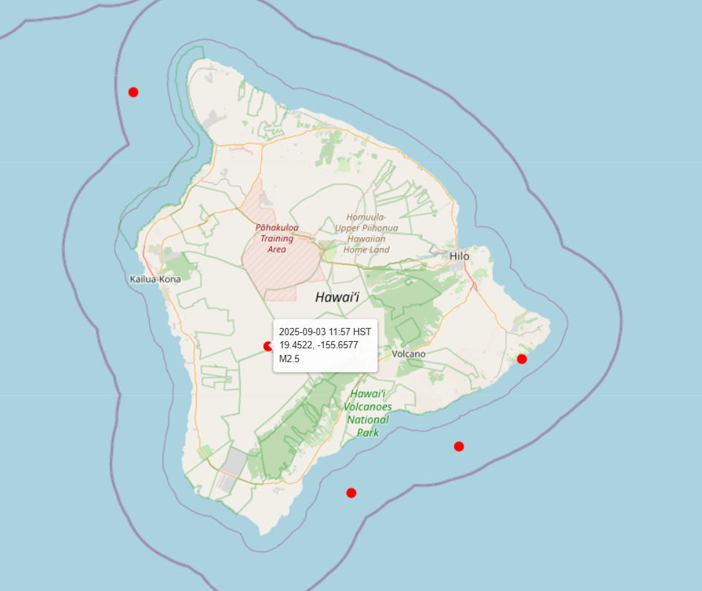
USGS Earthquakes

Slide 6

Honolulu 311: Reports
Phase 1 — Acquire
Data Source: data.honolulu.gov
Method: HTTP GET (CSV Export)
Data Type: CSV
Phase 2 — Normalize
Convert CSV to DF
Assign columns: RequestType, StatusType, Description, Location
Phase 3 — Shape for Map
Convert DF to GeoDF
Select: category, status, latitude, longitude, description
CRS: Ensure EPSG:4326
Configure Tooltip Text:
Category, Status, Description
Phase 4 — Visualize
Configure Clustering:
Parse Location: (lat, lon)
Filter: Only keep reports that are active
Trim: Description (~200 chars) to minimize clutter
Configure Color-Coding
Folium FeatureGroup
Folium MarkerCluster
Yellow CircleMarker
Deploy HNL311 Layer

Slide 7
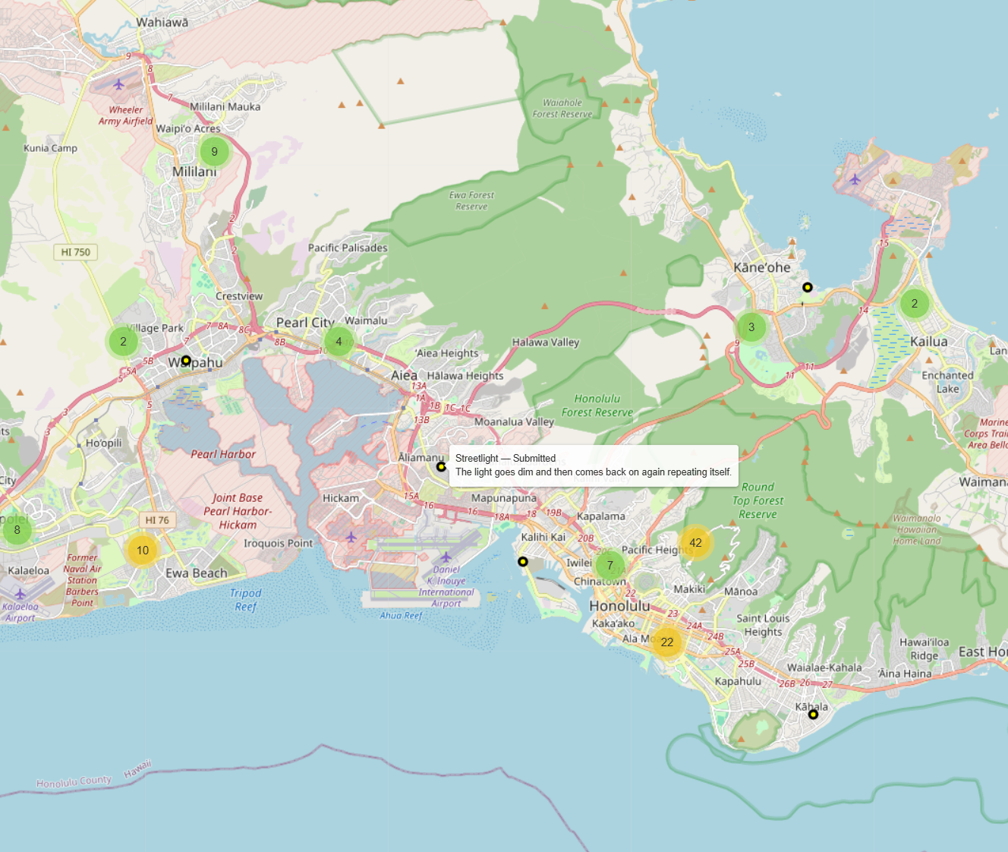
Honolulu 311 Reports

Slide 8
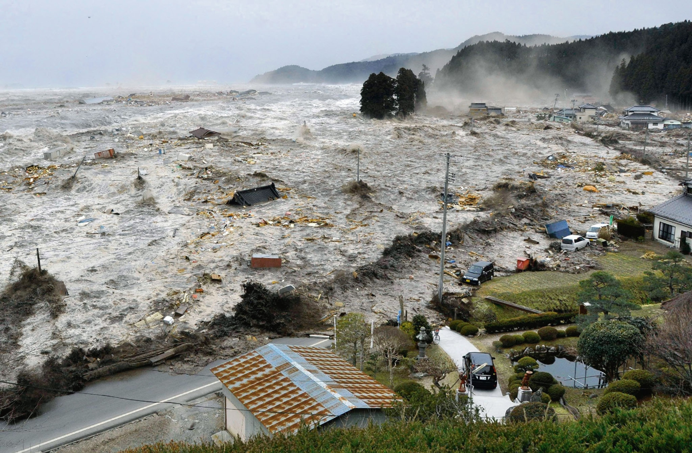
Hawaii GIS: Tsunami Zones
Phase 1 — Acquire
Data Source: Hawaii State ArcGIS
Method: geopandas.read_file(URL)
Data Type: GeoDF
Phase 2 — Normalize
CRS: Ensure EPSG:4326
Phase 3 — Shape for Map
Pass: GeoDF directly to Folium
Phase 4 — Visualize
Deploy Tsunami Layer

Slide 9
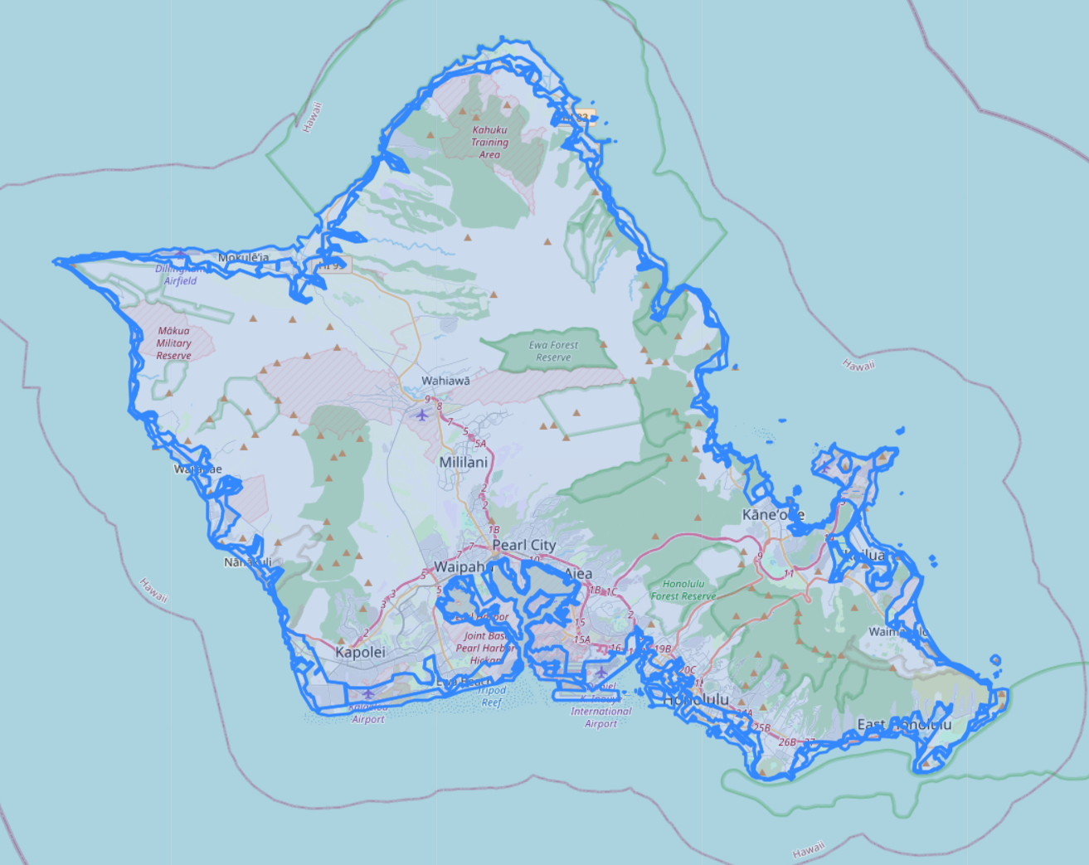
Hawaii GIS Tsunami Zones

Slide 10
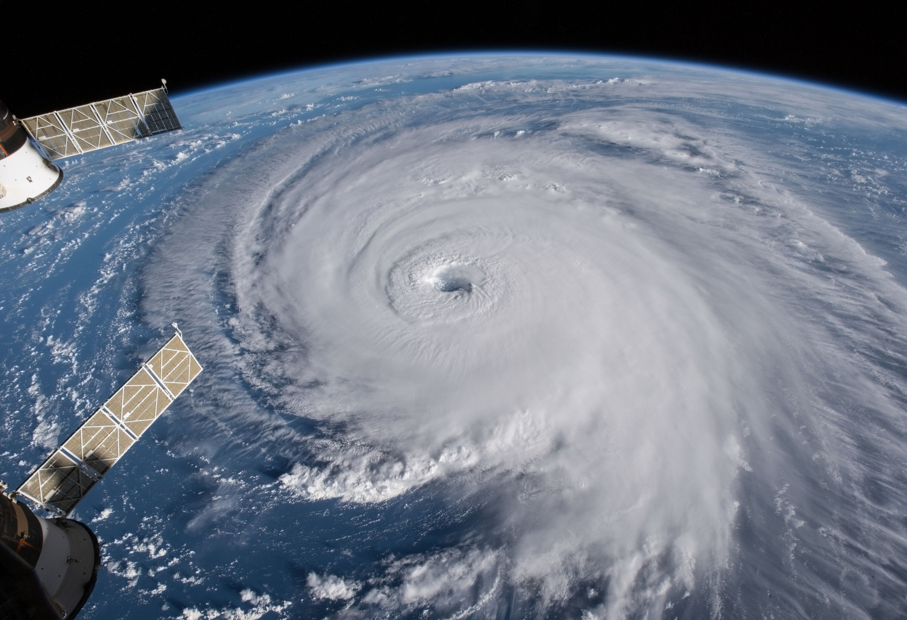
NWS: Weather Alerts
Phase 1 — Acquire
Data Source: api.weather.gov
Method: HTTP GET JSON
Data Type: GeoJSON
Phase 2 — Normalize
Select Properties: event, severity, certainty, effective, expires, areaDesc
Phase 3 — Shape for Map
Convert GeoJSON to DF
Render to HTML table
Phase 4 — Visualize
Deploy Branca MacroElement panel
Local Time Conversion: Convert epoch to HST

Slide 11
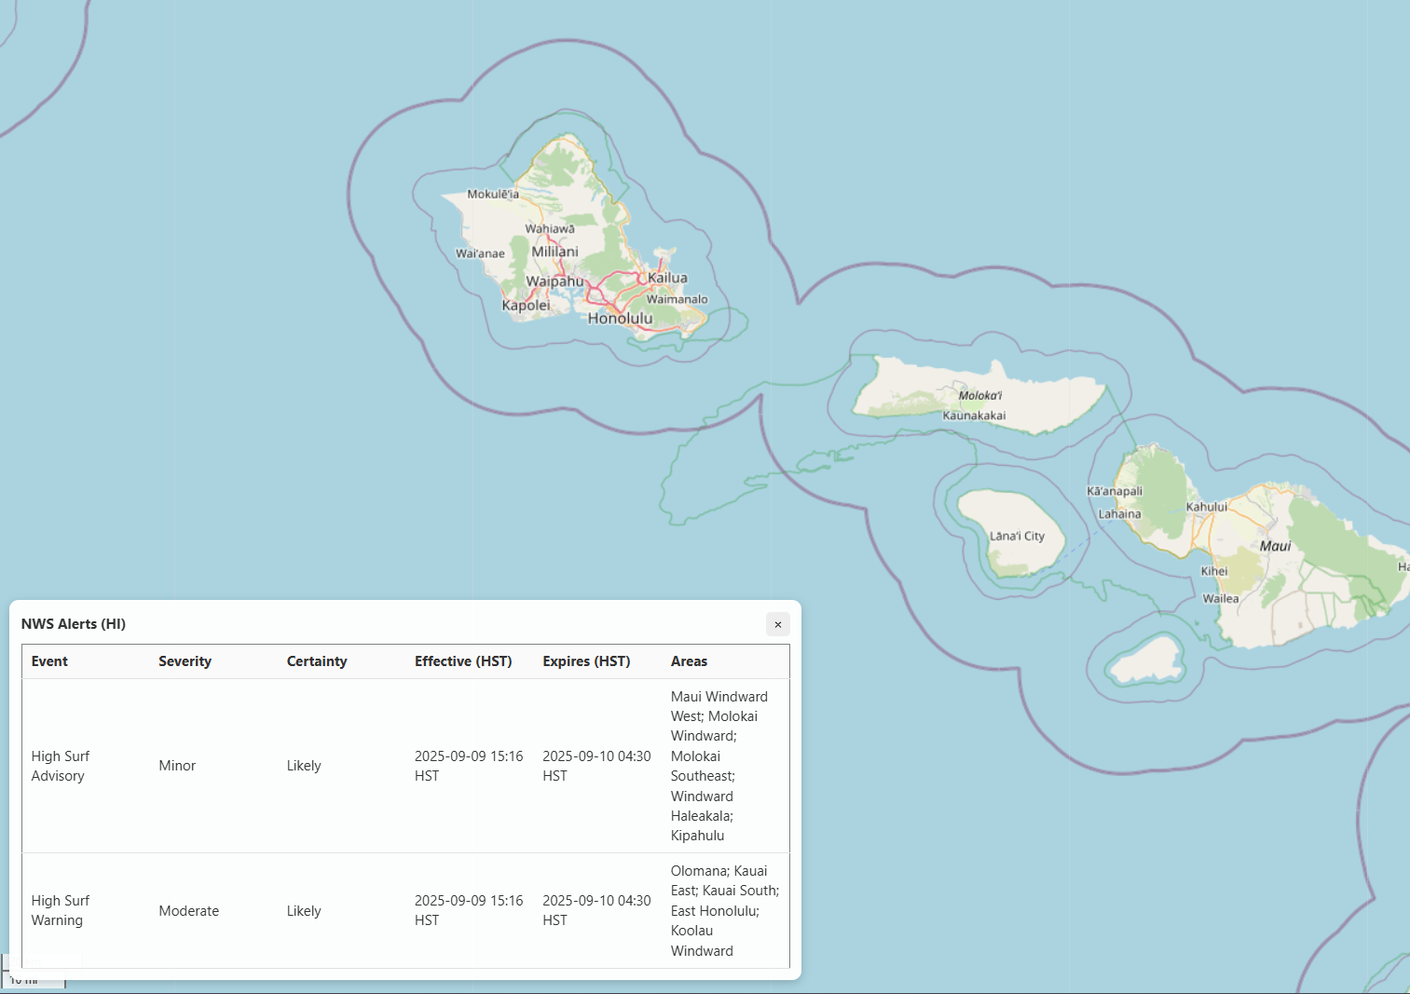
NWS Weather Alerts

Slide 12
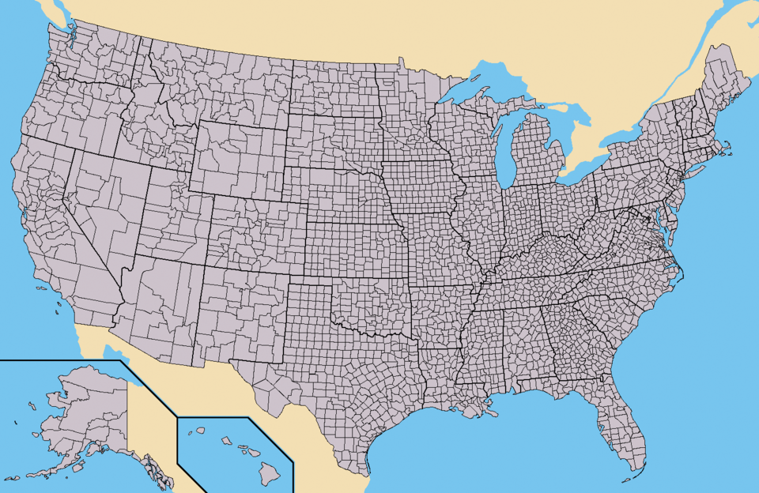
US Census: Hawaii Counties
Phase 1 — Acquire
Data Source: www2.census.gov
Method: Manual Download
Data Type: Zipped Shapefile
Phase 2 — Normalize
Convert .shp to GeoDF
Filter: STATEFP == '15' (Hawaiʻi)
Phase 3 — Shape for Map
Select: ['NAME','geometry'] only
Configure Tooltip Text:
Phase 4 — Visualize
Deploy County Layer
Rename: ‘label’ column to 'NAME’
CRS: Ensure EPSG:4326
Name

Slide 13
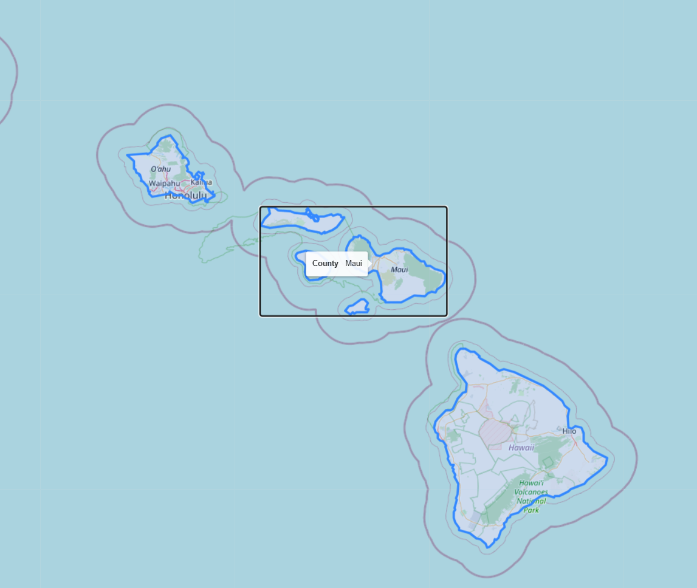
US Census Hawaii Counties

Slide 14
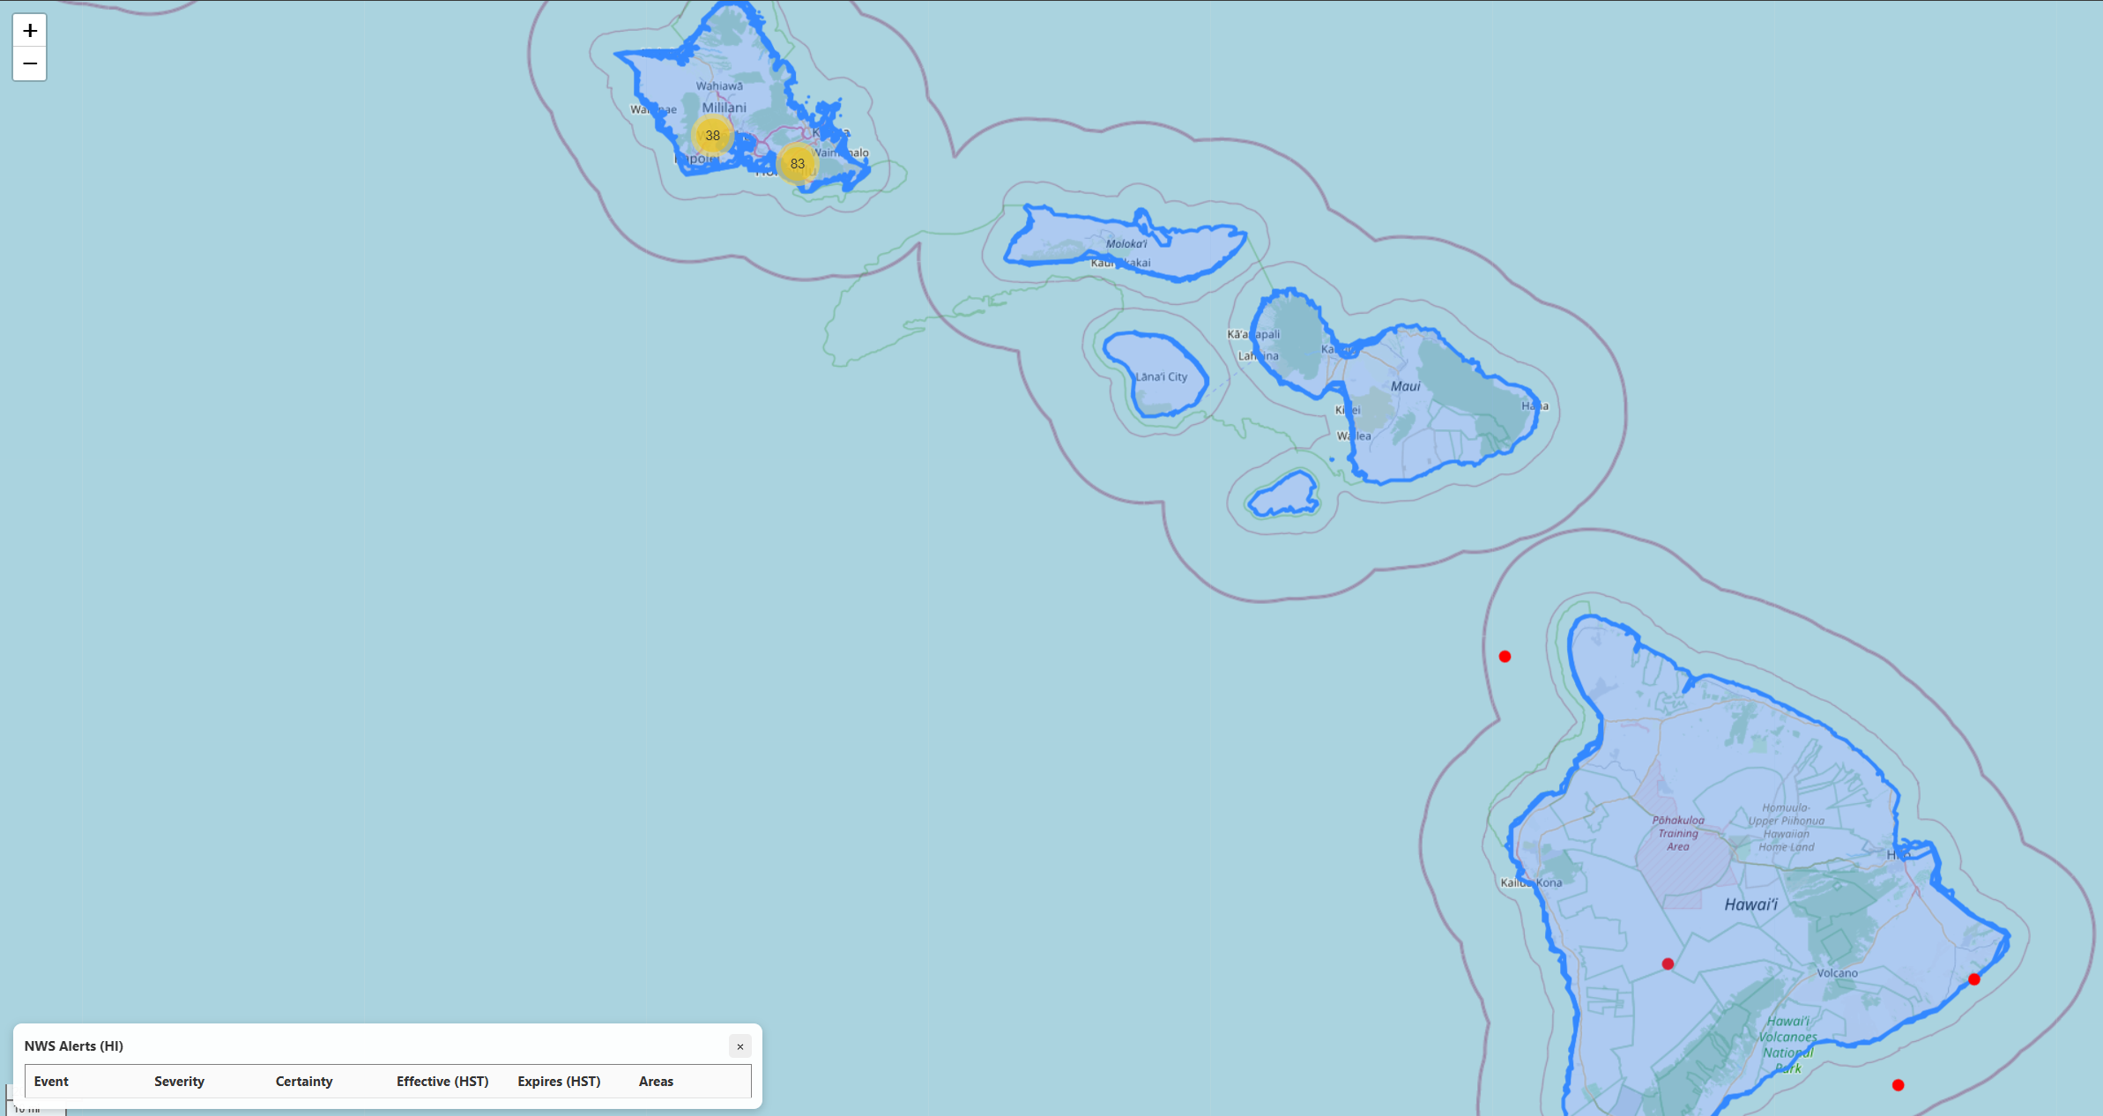
Final Product

Slide 15

Roadmap
Additional data sources:
Power outages, Water outages/boil-water advisories, road closures, wildfires, lava flow.
Troubleshoot and resolve certificate issues in fetching county data from census.gov
Currently just a manual download
Potentially expand the box of tracked earthquakes to cover a larger portion of the Pacific
Earthquakes occurring as far as Russia can still have significant impact on Hawaii
Determine a way to assign a static color to a parent node, regardless of how many children it has
Enable ease of distinguishing layer nodes from one another if multiple layers with nodes are simultaneously active
Is there any utility in tracking 7-days of historical earthquake data? Should we only track the current day?
Any given earthquake only has a ~5% of being a foreshock for a larger follow-on earthquake.
HNL county stakeholder engagement to determine order of urgency for HNL311 report categories
Color-code nodes based on level of urgency

